Slide 1
UNIT-III
Differential Calculus-II

Slide 2
Introduction
Topics | Hours | Assignment | % of Marks in exam
Taylor’s & Maclaurin’s Theorems | 1 | 2.1
Expansion of function of several variables | 1 |  | 10
Problems | 2
Jacobian | 2 | 2.2 | 5
Jacobian of Implicit Function | 1 |  | 10
Approximation of errors | 2 |  | 5
Extrema of functions of several variables | 1 | 2.3 | 5
Problems | 2
Lagrange’s method of multipliers | 1 |  | 10
Problems | 1

Slide 3
Introduction Topic 1
Topics | Hours | Assignment | % of Marks in exam
Taylor’s & Maclaurin’s Theorems | 1 | 2.1
Expansion of function of several variables | 1 |  | 10
Problems | 2

Slide 4
Expansion of function of one variable
Taylor’s Theorem
Let f(x + h) be a function of h ( x being independent of h) which can be expanded in powers of h and the expansion be differentiable any number of times, then
Put x = a

Slide 5
Again put , h = x - a we get
Put a = 0 and h = x
Which is known as Maclaurin’s theorem.

Slide 6
Solved Example.1
Expand in powers of x . Then find the series
for and hence determine the value of
upto five places of decimal. (MTU 2012)
Solution: Let
Also we know by Maclaurin’s theorem
Then we get

Slide 7
Cont…..
Replacing x by -x in it then
Then we can find
by putting x = 1/10, we get

Slide 8
FAQ Problems on Taylor and Maclaurin's Series
Expand in ascending powers of x up to x⁴.
(UPTU 2014)
Show that
(UPTU2015)
Calculate the approximate value of √10 to four decimal places by taking the first four terms of an appropriate Taylor’s expansion.
Ans: 3.16227

Slide 9
Expansion of functions of several variables

Slide 11
FAQ Questions on Expansion of several variables

Slide 14
Recap
Taylor’s & Maclaurin’s Theorems for one variable.
Expansion of function of several variables
Discussion on assignments.

Slide 15
Introduction Topic 2
Topics | Hours | Assignment | % of Marks in exam
Jacobian | 2 | 2.2 | 5
Jacobian of Implicit Function | 1 |  | 10
Approximation of errors | 2 |  | 5

Slide 16
JACOBIANS

Slide 17
FAQ on Jacobians

Slide 18
Properties of Jacobians

Slide 24
Cont…

Slide 26
Jacobian of implicit functions

Slide 28
Cont…

Slide 30
Errors and approximation

Slide 32
FAQ on Approximation of Errors

Slide 38
Recap
Jacobian and their properties.
Jacobian of Implicit Function.
Approximation of errors
Discussion on assignments

Slide 39
Introduction Topic 3
Topics | Hours | Assignment | % of Marks in exam
Extrema of functions of several variables | 1 | 2.3 | 5
Problems | 2
Lagrange’s method of multipliers | 1 |  | 10
Problemes | 1

Slide 40
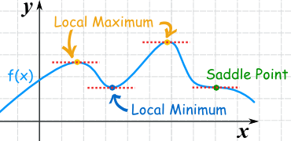
Extrema of functions of several variables
For single variable

Slide 41
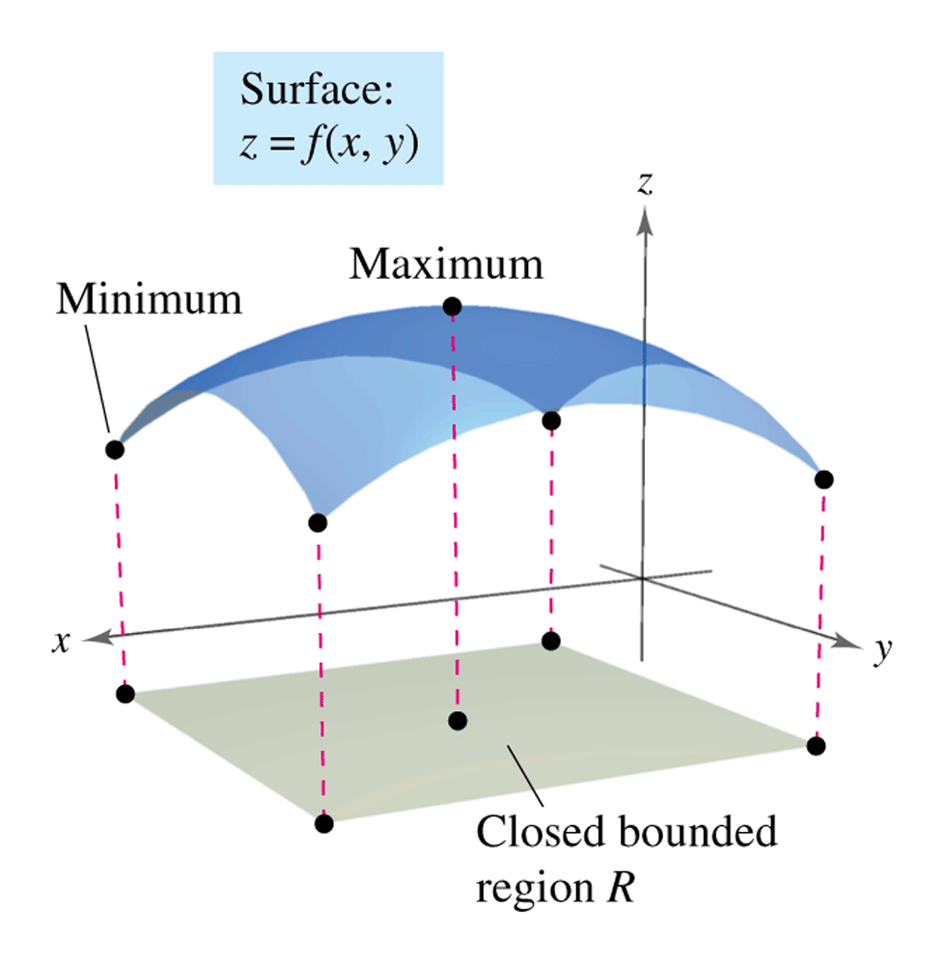
For several variable variable

Slide 42
Working Rule

Slide 44
FAQ on Extrema of several variable

Slide 46
Lagrange’s method of multipliers
Let be a function of three variables and the variables be connected by the relation
We construct an auxiliary equation
Differentiating eq. (ii) partially w.r.t. x,y,z

Slide 47
Eliminating from eqs.(iii),(iv),(v),the values of are obtained for which has stationary value. This method of obtaining stationary values of is called Lagrange’s method of undetermined multipliers an equation (iii),(iv )& (v) are called Lagrange’s equation. The term is called undetermined multiplier.
1. Find the extreme value of ,subject to the condition (UPTU2008)
Solution:
Lagrange’s equation ,

Slide 48
Solving these equation, we get
i.e.
Extreme value of
2. Find the dimensions of a rectangular box of maximum capacity whose surface area is given when
(i) box is open at the top (UPTU2009,2014)
(ii) Box is closed. (UPTU2009)

Slide 51
Recap
Extrema of functions of several variables.
Lagrange’s method of multipliers
Discussion on assignments.

Slide 52
Thank You!

